Slide 1

Movie Performance Analysis
Uncovering Success Factors in the Film Industry
Presented by Peter Muthoma

Slide 2
Contents
Introduction
01.
Problem Statement
02.
Top studios based on Gross Revenue
03.
Most produced Genre
04.
Movie Performance Over the Years
05.
Relationship Between Duration and Average Rating
06.
Correlation Between Gross Revenue and Average Rating
07.
Highest Grossing Genres
08.
Business Recommendations and Conclusion
09.

Slide 3
Introduction
This presentation contains a comprehensive analysis of movie performance, exploring the critical relationship between various factors influencing success in the film industry.
By leveraging a rich dataset encompassing movie titles, ratings, genres, and gross revenue, this project aims to provide valuable and actionable insights for Microsoft's new movie studio leadership. I will use exploratory data analysis to generate insights for these business stakeholder based on these data

Slide 4
Problem Statement
Microsoft is aiming to venture into the film industry by establishing a new movie studio. However, lacking expertise in movie production, they face the challenge of determining the most successful types of films at the box office.
The objective of this analysis is to explore and identify the key factors influencing movie success, such as top-performing genres, studios, and the relationship between average ratings and box office gross. By leveraging actionable insights derived from the analysis, the head of Microsoft's new movie studio can make informed decisions about the types of films to produce, thereby enhancing their chances of achieving financial success and critical acclaim in the competitive film market.

Slide 5
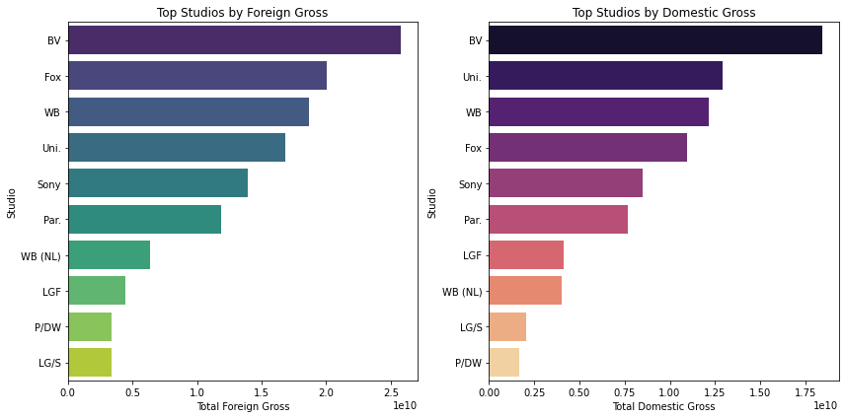
Top Studios Based on both Foreign and Domestic Gross
The studio performing exceptionally well in both the foreign and domestic markets is BV. It holds the top position in both categories, indicating its global success with blockbuster movies.
Fox, WB, Uni, and Sony are among the top studios in both markets, showing their ability to capture international audiences while maintaining a strong presence in the domestic market.
While some studios, like IFC and Magn have higher 'foreign_gross' revenue while their 'domestic_gross' revenue is relatively lower suggesting that they might be focusing more on international niche markets.

Slide 6
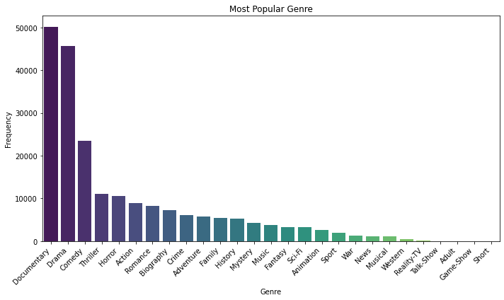
Most Produced Genre
Top Three Genres: Documentary dominates with 50,199 movies, Drama follows closely with 45,617 movies, and Comedy ranks third with 23,483 movies.
Diverse Genres for Exploration: Adventure, Romance, Biography, and Crime genres offer unique storytelling opportunities to attract diverse audience segments.
Strategic Genre Selection: Aligning with audience preferences, Microsoft can choose genres with widespread appeal for successful film productions.

Slide 7
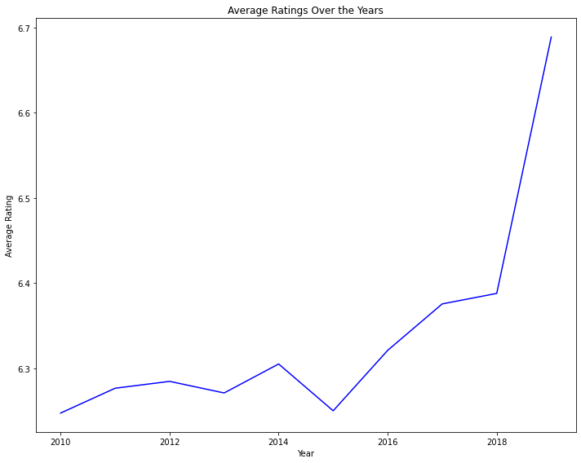
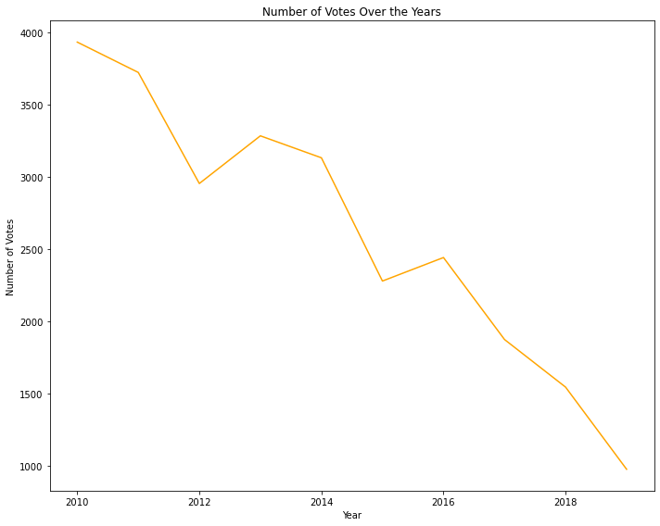
Average Ratings and Number of Votes Change Over the Years
Top Three Genres: Documentary dominates with 50,199 movies, Drama follows closely with 45,617 movies, and Comedy ranks third with 23,483 movies.
Diverse Genres for Exploration: Adventure, Romance, Biography, and Crime genres offer unique storytelling opportunities to attract diverse audience segments.
Strategic Genre Selection: Aligning with audience preferences, Microsoft can choose genres with widespread appeal for successful film productions.

Slide 8
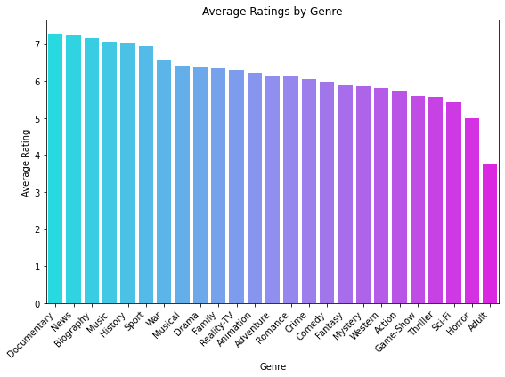
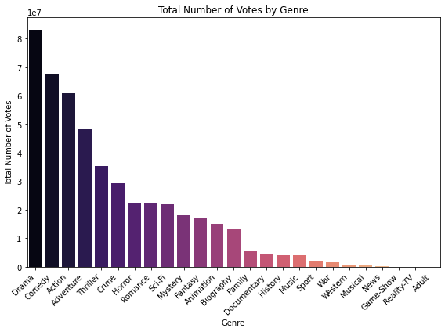
Relationship between the Duration of a Movie and its Average Rating
Genres like "Documentary," "News," and "Biography" demonstrate strong audience appeal and positive ratings, indicating potential opportunities for the studio to explore these genres in their movie productions. Considering the total number of votes received for each genre provides insights into the genres that resonate most with the audience and have the potential for higher viewership.

Slide 9
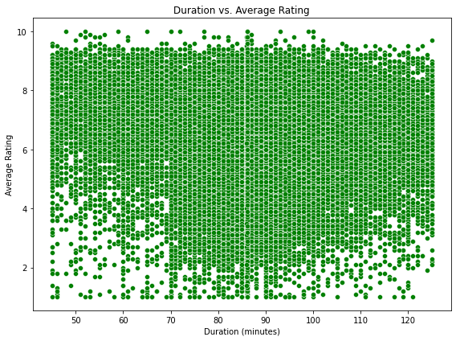
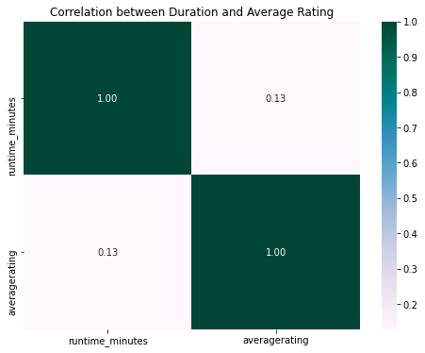
Relationship between the Duration and Average Rating
The correlation coefficient between Duration and average rating is approximately 0.13. This value indicates a weak positive correlation between the two variables.
In the context of Microsoft's new movie studio, the correlation suggests a modest linear relationship between a movie's duration and its average rating.
The positive correlation value implies that, on average, movies with slightly longer runtimes tend to have slightly higher average ratings. However, this correlation is not strong enough to be considered a decisive factor in determining a movie's rating.
For Microsoft's movie studio, focusing solely on producing lengthy films to achieve higher ratings may not be the most effective strategy. The studio should prioritize creating engaging and well-crafted movies that resonate with audiences.

Slide 10
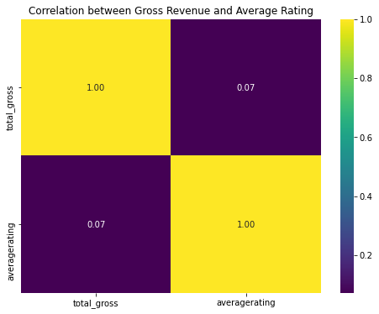
Correlation between Gross of a Movie and it's Averagerating
The correlation coefficient between gross revenue and average rating is approximately 0.07. This value is close to zero, indicating a weak positive correlation between the two variables.
The correlation suggests that there is a limited linear relationship between a movie's gross revenue and its average rating.
The positive correlation value indicates that, on average, movies with slightly higher ratings tend to have slightly higher gross revenue. However, this correlation is not strong enough to be considered a major contributing factor.

Slide 11
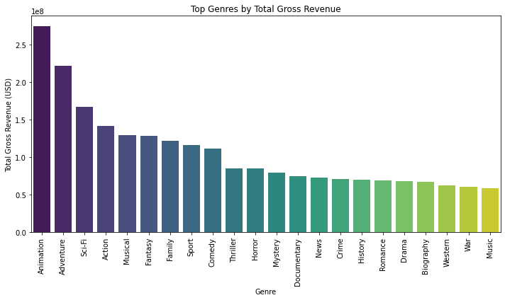
Highest Grossing Genres
From the above data we can tell that the top genres ranked by total gross revenue are Animation, Adventure, and Sci-Fi, indicating their potential for significant financial success at the box office.
Animation: As the highest-grossing genre, Animation boasts an average total gross revenue of approximately $274.6 million. The popularity of animated films, especially among family audiences, contributes to their strong financial performance.
Adventure: Adventure films secure the second spot, with an average total gross revenue of about $$221.3 million. The genre's captivating storytelling and thrilling experiences appeal to broad audiences, making it a promising choice for movie studio ventures.
Other Promising Genres: Action, Musical, and Fantasy follow closely in terms of total gross revenue, offering lucrative opportunities for Microsoft's movie studio.

Slide 12
Recommendation and Conclusion
Base on all the analysis done in this EDA and in alignment with both the problem statement and also the compeling data analysis we will recommend the following to the Head of Microsoft's Movie studio
Focus on Top-Performing Genres: Based on our analysis, genres such as Animation, Adventure, and Sci-Fi have demonstrated significant financial success in terms of total gross revenue. Microsoft Studio should prioritize producing films in these top-performing genres to enhance the likelihood of box office success.
Strategic Genre Diversification: While concentrating on high-grossing genres, the studio should also explore a diversified portfolio of films across various genres. This approach will enable the studio to appeal to diverse audience segments and broaden its market reach.
Invest in Quality Storytelling and Talent: Regardless of the genre, the key to success lies in compelling storytelling and talented cast and crew. Microsoft Studio should allocate resources to develop engaging narratives, collaborate with experienced filmmakers, and cast skilled actors to deliver exceptional cinematic experiences.
Embrace Data-Driven Decision Making: Leverage the power of data analytics and audience insights to drive decision-making processes. Analyzing viewer preferences, market trends, and industry benchmarks will inform content creation, marketing strategies, and release schedules.

